Slide 1
Rich feature hierarchies for accurate object detection and semantic segmentation
2014 IEEE Conference on Computer Vision and Pattern Recognition
Ross Girshick, Jeff Donahue, Trevor Darrell, Jitendra Malik
UC Berkeley

Slide 2
Outline
Introduction
Object detection with R-CNN
Visualization, ablation, and modes of error
Semantic segmentation
Conclusion

Slide 3
Outline
Introduction
Object detection with R-CNN
Visualization, ablation, and modes of error
Semantic segmentation
Conclusion

Slide 4
Introduction
In this paper, we propose a simple and scalable detection algorithm that improves mean average precision (mAP) by more than 30% relative to the previous best result on VOC 2012—achieving a mAP of 53.3%

Slide 5
Introduction
Our approach combines two key insights :
Apply high-capacity convolutional neural networks (CNNs) to bottom-up region proposals in order to localize and segment objects
When labeled training data is scarce, supervised pre-training for an auxiliary task, followed by domain-specific fine-tuning, yields a significant performance boost

Slide 6
Outline
Introduction
Object detection with R-CNN
Visualization, ablation, and modes of error
Semantic segmentation
Conclusion

Slide 7
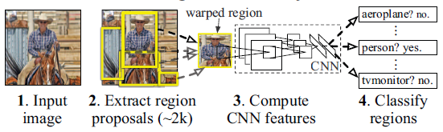
Object detection with R-CNN
R-CNN

Slide 8
Object detection with R-CNN
Our object detection system consists of three modules :
Region proposals
Feature extraction
A set of classifiers

Slide 9
Region proposals
Objectness [1]
Selective search [34]
Category-independent object proposals [12]
Constrained parametric min-cuts (CPMC) [5]
Multi-scale combinatorial grouping [3]
Ciresan, et al. [6] (Mitosis detection in breast cancer)

Slide 10
Region proposals
Objectness [1]
Selective search [34]
Category-independent object proposals [12]
Constrained parametric min-cuts (CPMC) [5]
Multi-scale combinatorial grouping [3]
Ciresan, et al. [6] (Mitosis detection in breast cancer)

Slide 11
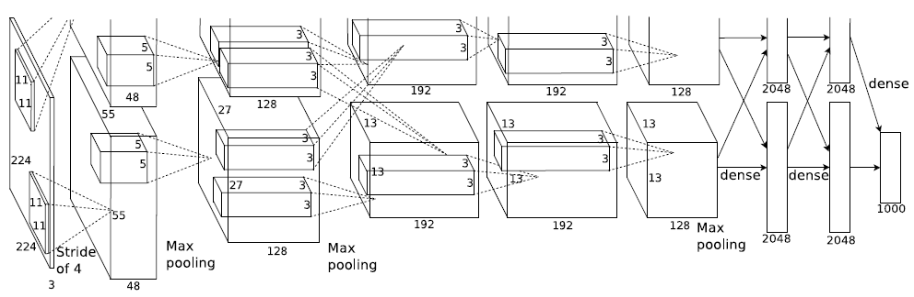
Feature extraction
We extract a 4096-dimensional feature vector from each region proposal using the Caffe [22] implementation of the CNN described by Krizhevsky et al. [23] (AlexNet)

Slide 12
Feature extraction
Features are computed by forward propagating a mean-subtracted 227 × 227 RGB image
We warp all pixels in a tight bounding box around it to the required size
Dilate the tight bounding box so that at the warped size there are exactly p pixels of warped image context around the original box (we use p = 16)
Outperformed 3-5 mAP points

Slide 13
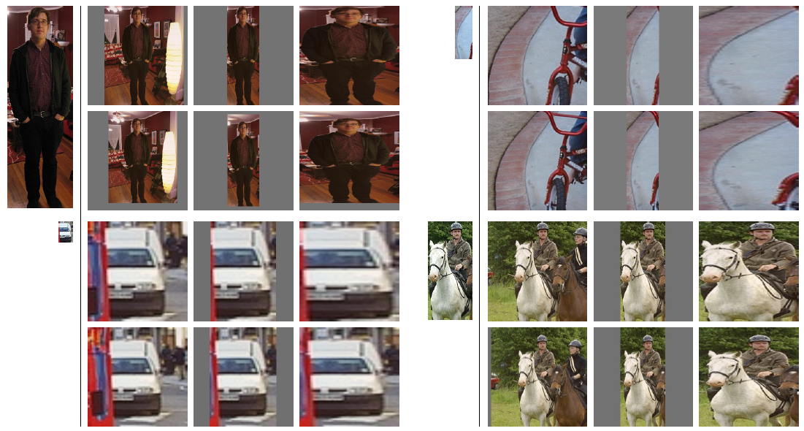
Feature extraction

Slide 14
Feature extraction
Training :
Supervised pre-training Using the open source Caffe CNN library
Domain-specific fine-tuning We continue stochastic gradient descent (SGD) training of the CNN parameters using only warped region proposals from Visual Object Classes (VOC)

Slide 15
Feature extraction
Replacing the CNN’s ImageNet-specific 1000-way classification layer with a randomly initialized (N+1)-way (VOC N=20) classification layer (N classes + 1 background)
We treat all region proposals with ≥ 0.5 intersection-over-union(IoU) overlap with a ground-truth box as positives
SGD learning rate = 0.001 (1/10th of the initial pre-training rate)
In each SGD iteration, we uniformly sample 32 positive windows (over all classes) and 96 background windows

Slide 16
A set of classifiers
Linear SVMs
Training binary classifiers
Non-maximum suppression
Below an IoU overlap threshold (0.3) which regions are defined as negatives
Positive examples are defined simply to be the ground-truth bounding boxes for each class
Proposals that fall into the grey zone (more than 0.3 IoU overlap, but are not ground truth) are ignored

Slide 17
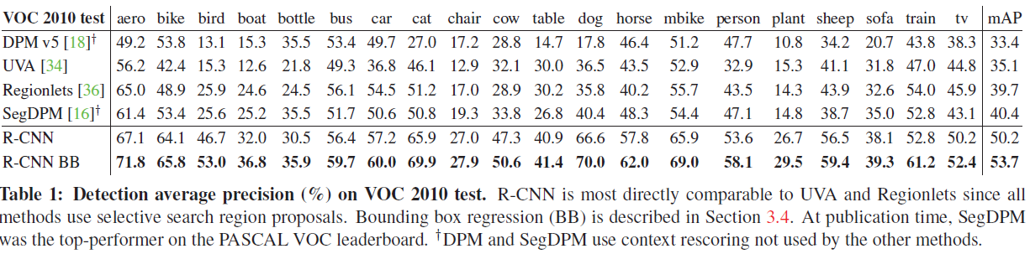

Slide 18
Outline
Introduction
Object detection with R-CNN
Visualization, ablation, and modes of error
Semantic segmentation
Conclusion

Slide 19
Visualization, ablation, and modes of error
Visualizing learned features
Ablation studies
Detection error analysis
Bounding box regression

Slide 20
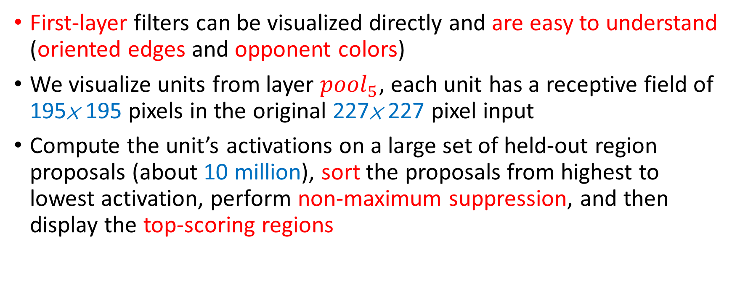
Visualizing learned features
First-layer filters can be visualized directly and are easy to understand (oriented edges and opponent colors)
We visualize units from layer ${pool}_{5}$, each unit has a receptive field of 195× 195 pixels in the original 227× 227 pixel input
Compute the unit’s activations on a large set of held-out region proposals (about 10 million), sort the proposals from highest to lowest activation, perform non-maximum suppression, and then display the top-scoring regions

Slide 21
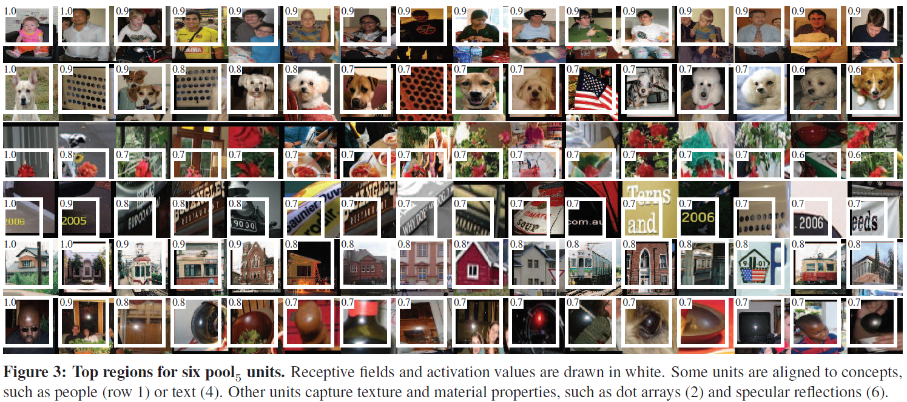

Slide 22
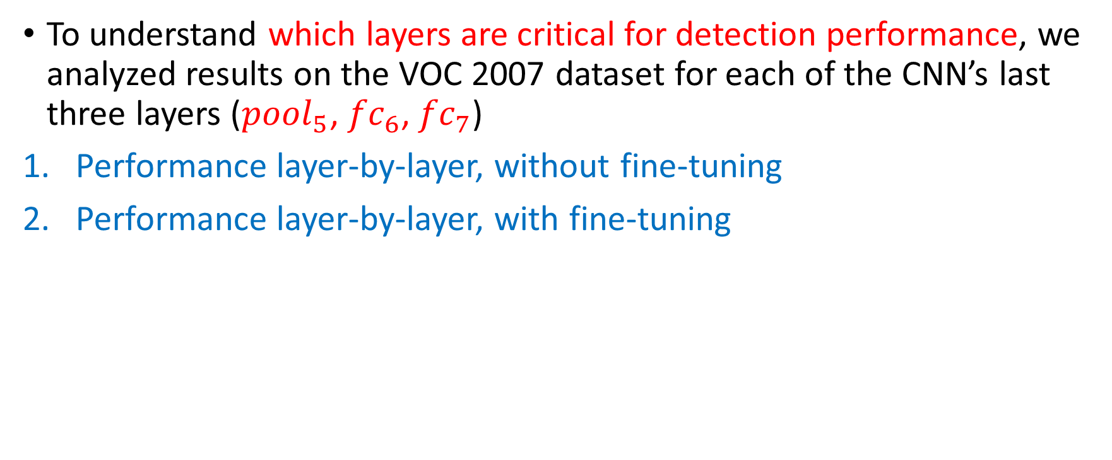
Ablation studies
To understand which layers are critical for detection performance, we analyzed results on the VOC 2007 dataset for each of the CNN’s last three layers (${pool}_{5}$, ${fc}_{6}$, ${fc}_{7}$)
Performance layer-by-layer, without fine-tuning
Performance layer-by-layer, with fine-tuning

Slide 23
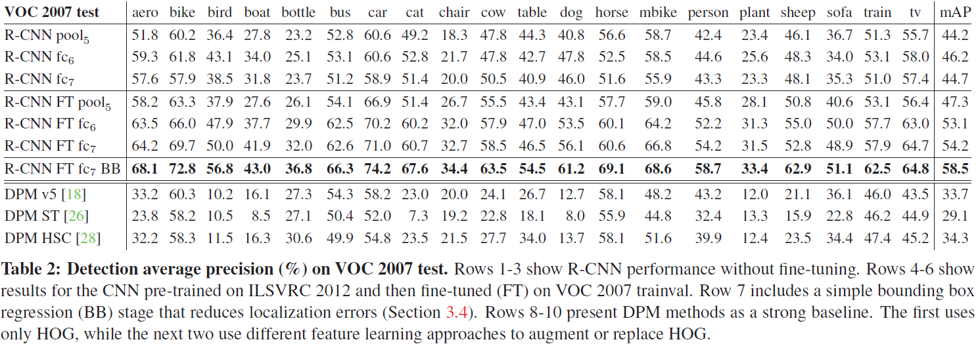

Slide 24
Detection error analysis
[21] D. Hoiem, Y. Chodpathumwan, and Q. Dai. Diagnosing error in object detectors. In ECCV. 2012.
To understand some finer details, we applied the excellent detection analysis tool from Hoiem et al. [21] in order to reveal our method’s error modes, understand how fine-tuning changes them, and to see how our error types compare with DPM
False positive
False negative

Slide 25
Detection error analysis – False Positive
Loc — poor localization (a detection with an IoU overlap with the correct class between 0.1 and 0.5, or a duplicate)
Sim — confusion with a similar category
Oth — confusion with a dissimilar object category
BG — a FP that fired on background

Slide 26
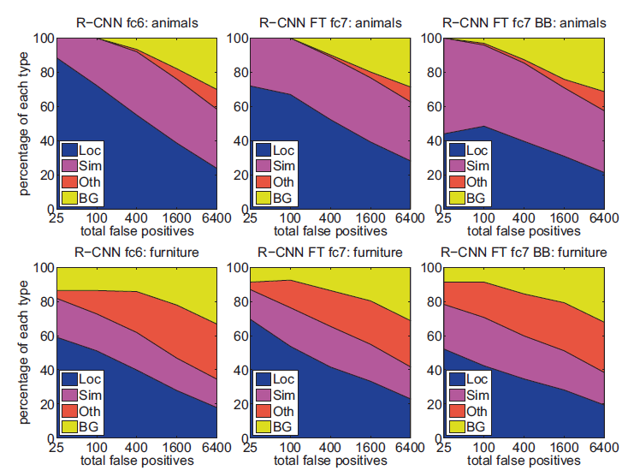

Slide 27
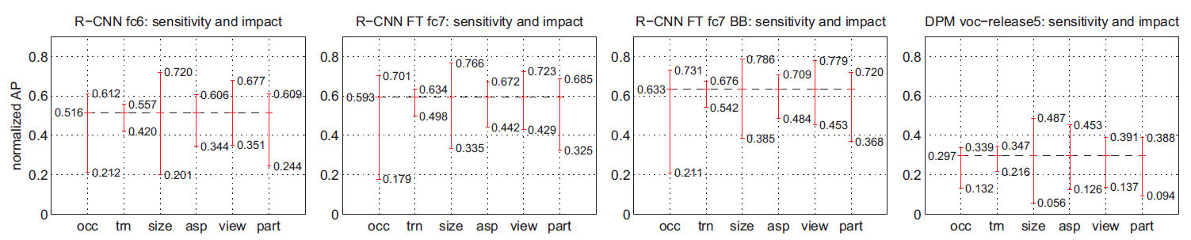
Detection error analysis – False Negative
Sensitivity to object characteristics
Occlusion, Truncation, Bounding box area, Aspect ratio, Viewpoint, Part visibility
Fine-tuning does not reduce sensitivity

Slide 28
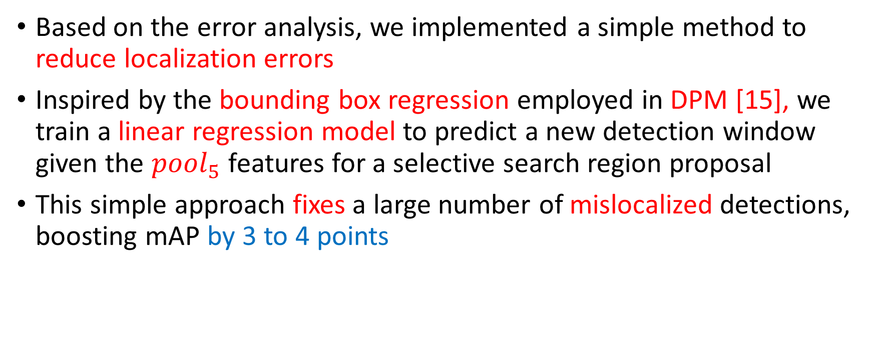
Bounding box regression
Based on the error analysis, we implemented a simple method to reduce localization errors
Inspired by the bounding box regression employed in DPM [15], we train a linear regression model to predict a new detection window given the ${pool}_{5}$ features for a selective search region proposal
This simple approach fixes a large number of mislocalized detections, boosting mAP by 3 to 4 points

Slide 29
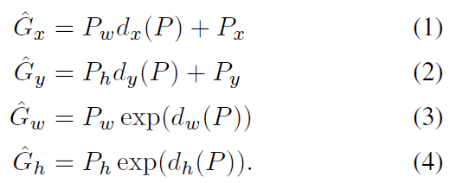
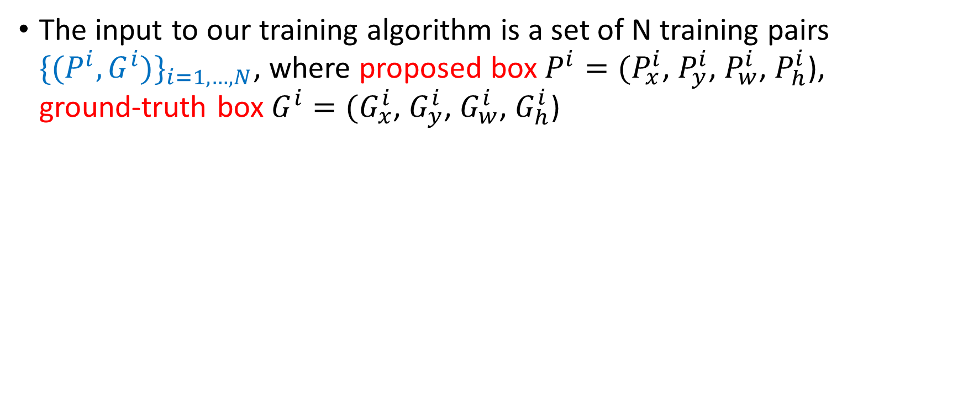
Bounding box regression
The input to our training algorithm is a set of N training pairs ${\{(P^{i},G^{i})\}}_{i=1,…,N}$, where proposed box$P^{i}=(P_{x}^{i}$, $P_{y}^{i}$, $P_{w}^{i}$, $P_{h}^{i}$), ground-truth box$G^{i}=(G_{x}^{i}$, $G_{y}^{i}$, $G_{w}^{i}$, $G_{h}^{i}$)
scale-invariant translation
log-space translations

Slide 30
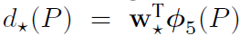
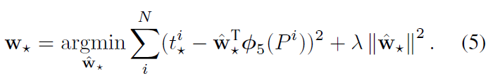
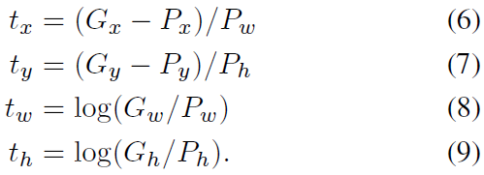
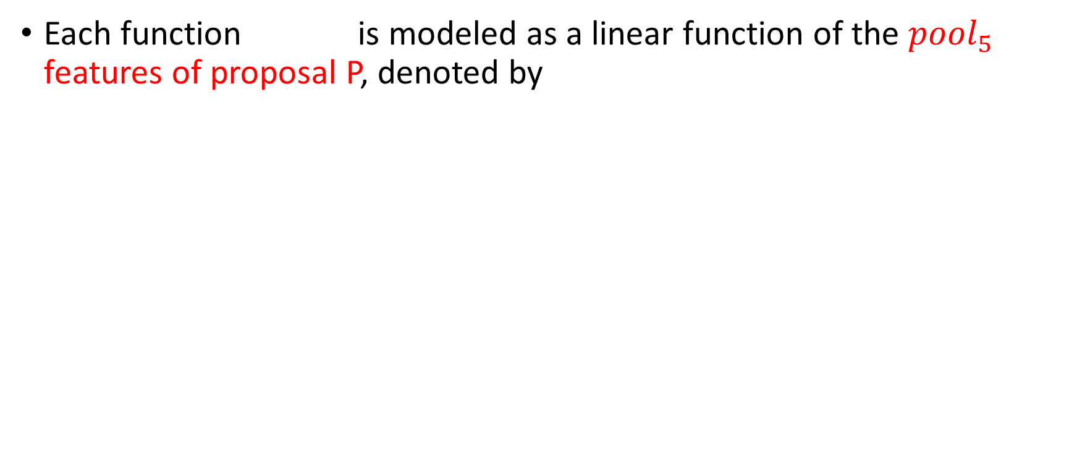
Bounding box regression
Each function is modeled as a linear function of the ${pool}_{5}$ features of proposal P, denoted by
We learn by optimizing the regularized least squares objective

Slide 31
Outline
Introduction
Object detection with R-CNN
Visualization, ablation, and modes of error
Semantic segmentation
Conclusion

Slide 32
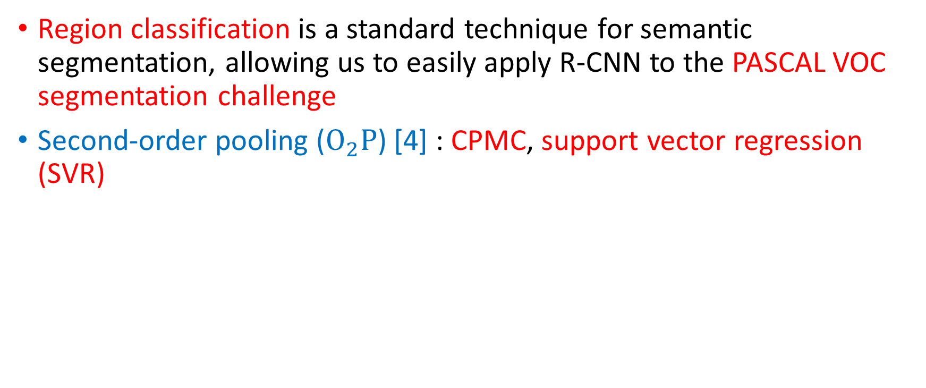
Semantic segmentation
Region classification is a standard technique for semantic segmentation, allowing us to easily apply R-CNN to the PASCAL VOC segmentation challenge
Second-order pooling ($O_{2}P$) [4] : CPMC, support vector regression (SVR)

Slide 33
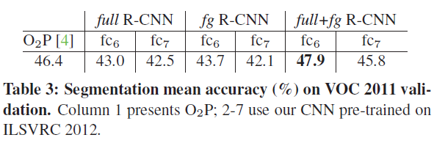
Semantic segmentation
CNN features for segmentation , three strategies :
Full : Ignores the region’s shape and computes CNN features directly on the warped window. However, two regions might have very similar bounding boxes while having very little overlap
FG : Foreground mask. We replace the background with the mean input so that background regions are zero after mean subtraction

Slide 34
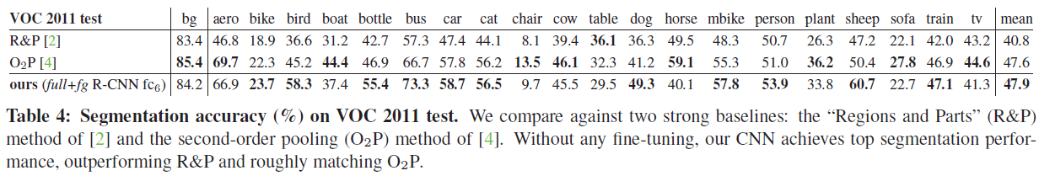
Semantic segmentation

Slide 35
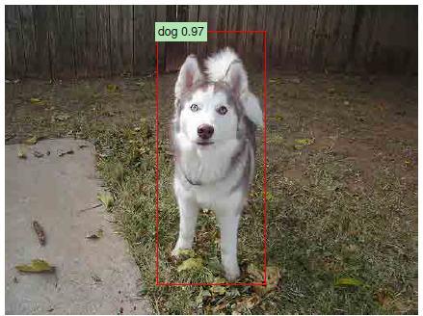
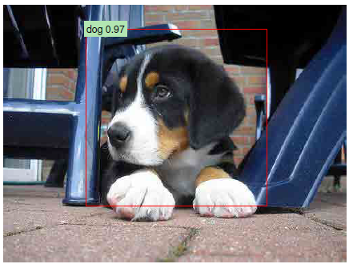

Slide 36
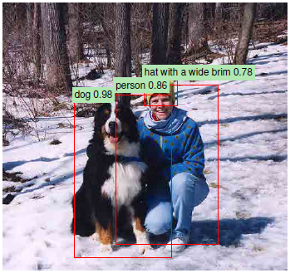
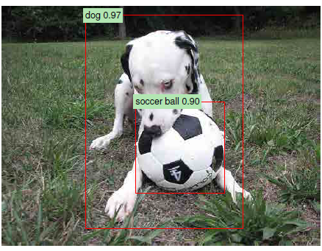

Slide 37
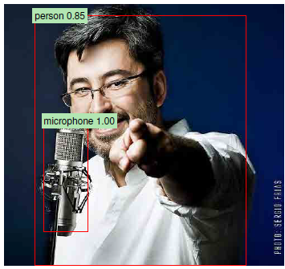
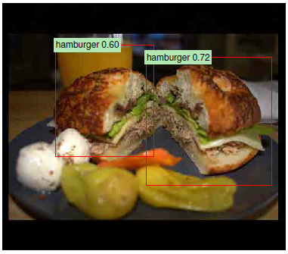

Slide 38
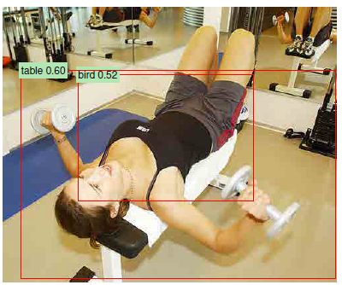
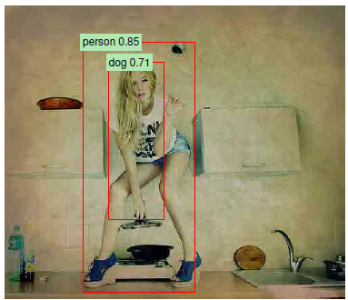

Slide 39
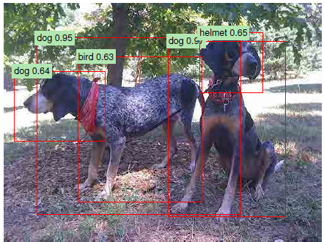
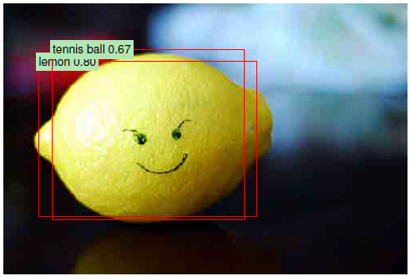

Slide 40
Outline
Introduction
Object detection with R-CNN
Visualization, ablation, and modes of error
Semantic segmentation
Conclusion

Slide 41
Conclusion
This paper presents a simple and scalable object detection algorithm that gives a 30% relative improvement over the best previous results on PASCAL VOC 2012
We achieved this performance through two insights :
Apply high-capacity convolutional neural networks to bottom-up region proposals in order to localize and segment objects
A paradigm for training large CNNs when labeled training data is scarce
We show that it is highly effective to pre-train the network with supervision and then fine-tune

Slide 42
Thanks for listening!

